Slide 1
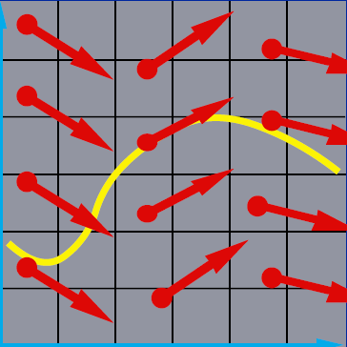
Numerical Solution of Ordinary Differentiation Equations
x₂
x₁

Slide 2
Numerical Methods for ODEs
Taylor Series
Euler’s method: one-term
Runge-Kutta method: higher-order terms
Multistep method
Stability of ODE solutions
Implicit method

Slide 3
Single Step vs. Multistep
Single step methods
only use the information in the last step
can perform the next step with a different step size
good for starting the numerical solution of ODE
Multistep methods
utilize the past values of x and/or x’ to construct a polynomial that approximates f(x,t)
use the polynomial to extrapolate in the next step

Slide 4
Adams Method: 3 steps/3rd order
Reformulate ODE solving as a numerical quadrature problem
Apply method of undetermined coefficients
x is a function of t

Slide 5
Adams Method: 3 steps/3rd order (cont.)
Apply method of undetermined coefficients
Interpolate 3 points (0, f_{n}), (-h, f_{n-1}), (-2h, f_{n-2})

Slide 6
Adams Method: 3 steps/3rd order (cont.)
Apply method of undetermined coefficients
Interpolate 3 points (0, f_{n}), (-h, f_{n-1}), (-2h, f_{n-2})

Slide 7
Adams Method: 3 steps/3rd order (cont.)
Solving linear system
3rd-order Adams method

Slide 8
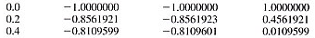
Example: Adams Method
Solve
Initial guess from Runge-Kutta-Fehlberg method
t
x
x, analytical
f(t,x)
Notes:
We need the results in previous two steps. RKF method is used to compute the initial guess

Slide 9
Adams Method: Fourth-Order Formula
Same game, but now using 4 previous steps
Solving linear system

Slide 10
Adams Method: Fourth-Order Formula
Solving for the coefficients, we obtain
where the error term can be computed by integrating the error of cubic interpolating polynomial

Slide 11
Adam-Moulton Method
Improvement over the Adams method using a predictor-corrector scheme
First compute x_{n+1} using predictor
Compute derivative f_{n+1}=f(x_{n+1}, t_{n+1} )
Recompute x_{n+1} using corrector

Slide 12
Derivation of Corrector Formula
You can confirm this using the undetermined coefficients!
Four terms rule: f_{n+1}, f_{n} , f_{n-1} , f_{n-2}

Slide 13
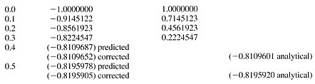
Example: Adam-Moulton Method
Solve
Predictor
t
x
f(t,x)
x, analytical

Slide 14
Example: Adam-Moulton Method
Evaluate f_{n+1}=f(0.4, -0.8109687) = 0.0109688
Corrector
t
x
f(t,x)
x, analytical

Slide 15
Stability of Analytic Solution of ODE
Stable if solutions resulting from perturbations of initial value remain close to original solution
Unstable if solutions resulting perturbations diverges away from original solution without bound
Neutrally stable if solutions resulting from perturbations are neither stable or unstable

Slide 16
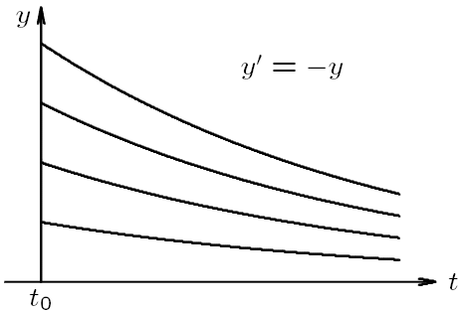
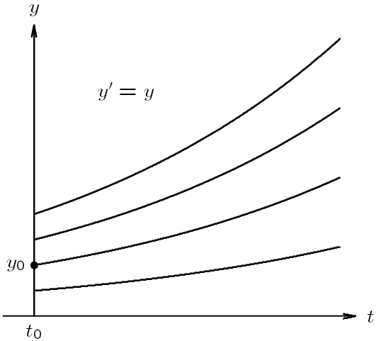
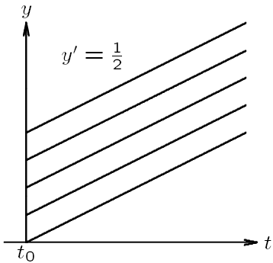
Example: Stability of ODE
Stable
Unstable
Neutrally
stable

Slide 17
Stability of Numerical Solutions of ODE
Numerical solution is stable if small perturbations do not cause resulting numerical solutions to diverge from each other without bound
Divergence of numerical solutions could be caused by instability of analytical solution to ODE, or due to numerical method itself, even when solutions to ODE is stable

Slide 18
Determining Stability and Accuracy
Simple approach to determining the stability and accuracy of a numerical method is to apply it to a scalar ODE x’=Ax, where A is a (possibly complex) constant
For a given numerical method, we can determine
its stability by characterizing the growth of numerical solution
its accuracy by comparing the exact and numerical solutions

Slide 19
Example: Euler’s Method
Applying Euler’s method to x’=Ax using a fixed step size h, we have
If Re(A) < 0, exact solution is stable, and numerical solution is also stable if
If A<0 is real, we must have h<-2/A for Euler’s method to be stable

Slide 20
Propagated Error
Error made early in the process will also affect the late computations—the early error will be propagated
Propagated error analysis is not easy
We only analyze the propagated error for Euler’s method here

Slide 21
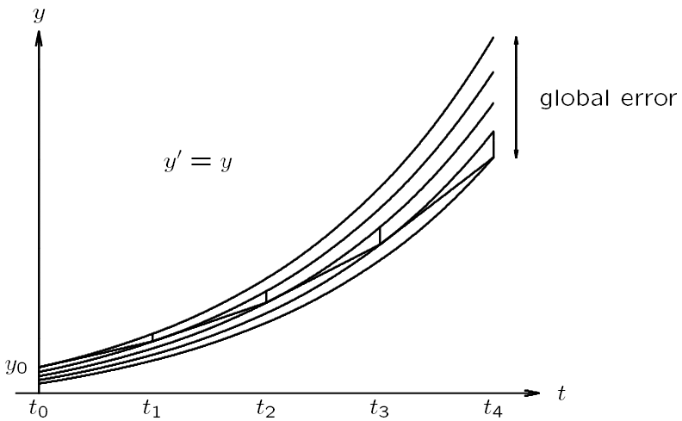
Local Error vs. Global Error
x
x’=x
local error
x₀
From Michael T. Heath

Slide 22
Local Error vs. Global Error
Local error: error made in one step of numerical method
where u_{n-1} is the member of the solution curves that passes through (x_{n-1},t_{n-1})
Global error: difference between computed solution and true solution determined by initial values at t₀

Slide 23
Propagated Error—Euler’s method
Euler’s method
By Taylor series
Numerical solution

Slide 24
Propagated Error—Euler’s method

Slide 25
Propagated Error—Euler’s method
Global error is the sum of propagated error and local error
Truncation error at each step is propagated to every later step with a growth factor (1+hK) each time!

Slide 26
Propagated Error—Euler’s method
Error does not grow if
This can be generated to higher-order case
Error does not grow if the norm of all eigenvalues of (I+hJ_{f}) less than 1
Jacobian of f:

Slide 27
Stability of Numerical Methods for ODEs
In general, growth factor depends on
Numerical method, which determines form of growth factor
Step size h
ODE, which determines Jacobian J_{f}

Slide 28
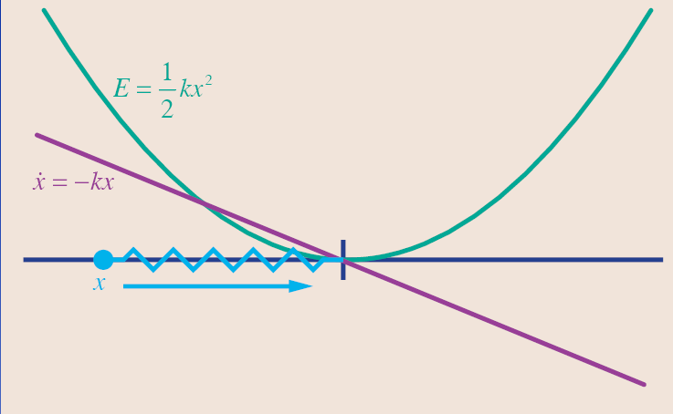
Stiff Equations
Damper system
Let’s consider a simple ODE x’=-kx
k can be viewed as a stiffness constant

Slide 29
Some Physics: Spring-Damper System
Spring force
Damping force: reduce the amplitude of oscillation

Slide 30
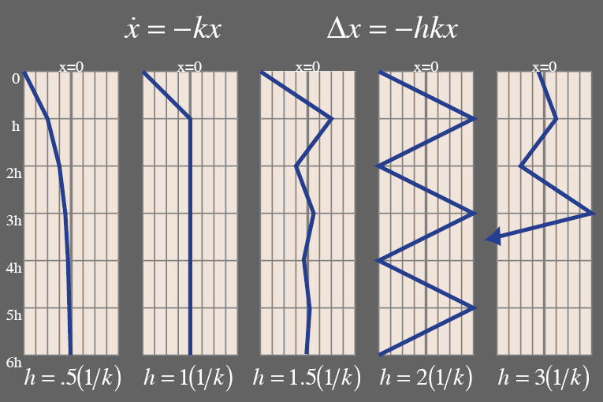
Step size of Euler’s method is limited by k
If h > 2/k, explode!
For a big k, h needs to be very small!
For convergence:

Slide 31
Stiff Equations
In more complex system, step size is limited by the largest k.
One stiff spring can screw it up for everyone else
Systems that have some big k’s mixed in are called stiff systems
Remedy to stiff equations
Using small step size → very inefficient
Implicit methods

Slide 32
Implicit Method
Euler’s method is explicit in that it uses only information at time t_{n} to advance solution to time t_{n+1}
Larger stability region can be achieved using information at time t_{n+1}, which makes method implicit
y=f(t): y is an explicit function of t f(y,t)=0: y is an implicit function of t

Slide 33
Backward Euler Method
Explicit Euler Method
Implicit (Backward) Euler Method
Example: x’=-kx
In this case,
stable for any h > 0

Slide 34
Implicit Method
We must evaluate f with x_{n+1} before we know its value
Therefore, we need to solve algebraic equation to determine x_{n+1} → root finding
Typically, we use Newton method or fixed-point iteration method to solve for x_{n+1}
Good starting guess for iteration can be obtained from explicit methods

Slide 35
Example: Backward Euler Method
http://www.cs.illinois.edu/~heath/iem/ode/backeulr/

